Slide 1

“Capital Bikeshare System, Washington DC, U.S.A”
Kaggle Competition
(Term Project)
School of Computing and Information
Presented by
Jiayu Chen(jic117@pitt.edu)
Xuechun Dong(xud8@pitt.edu)
Zhiming Yang (zhy61@pitt.edu)
04/15/2017 Information Science Buidling

Slide 2




Introduction
As a newly emerging public transportation in cities, bike sharing systems, the product of a new era of technologies, gradually replace the traditional bike rentals.
2011
Train set: first 20 days of each month
2012
Test set: the rest of days of each month
Our mission is to optimize the predicted models through the train set and to analyze the prediction of the total count of bikes based on the features given by test set.
https://www.capitalbikeshare.com/
https://en.wikipedia.org/wiki/Capital_Bikeshare
http://territoriosociales.blogspot.com/2017/11/weather.html
https://www.123rf.com/photo_75335531_stock-vector-cold-and-hot-temperature-vector-icon.html
https://www.neofarmers.com/Environmental-control/rh-controller

Slide 3

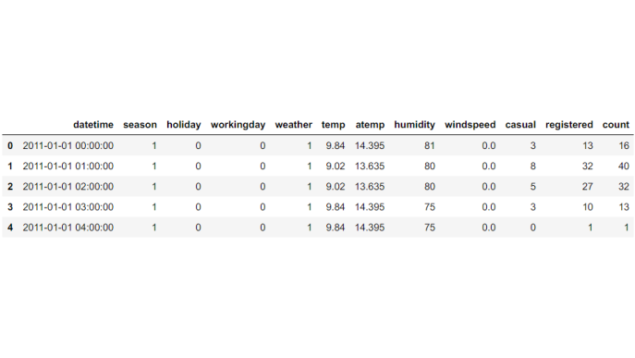
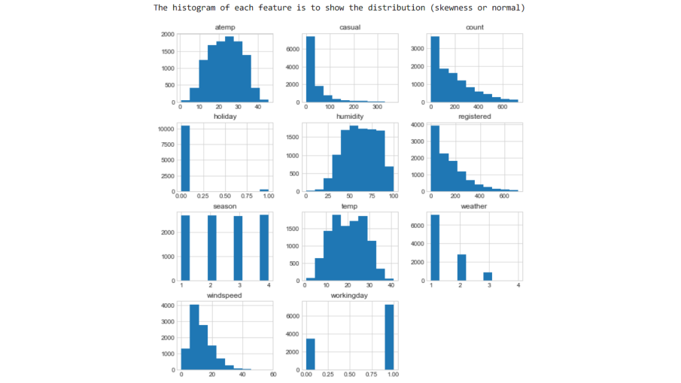
Background
Bike sharing systems adopt dynamic pricing model regarding to environmental and seasonal settings, including weather conditions, season of year, day of week, hour of the day, etc. to maximize the market value.
train set: 10886 values with 12 columns
test set: 6493 values with 9 columns
no missing values – Bad or Good?
Sample: first 5 rows in train set
Distribution of each feature
https://www.kaggle.com/c/bike-sharing-demand

Slide 4
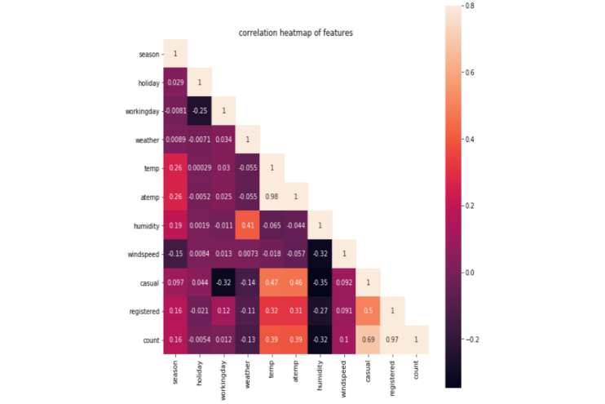
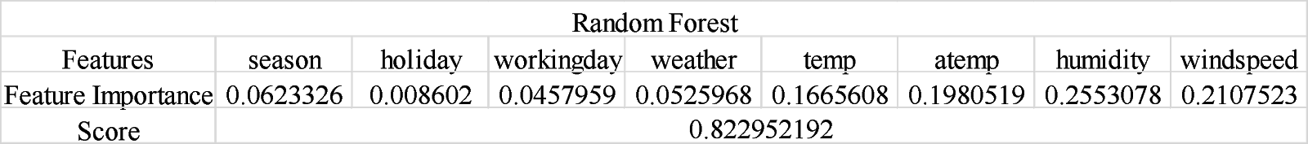


Pre-processing
Limitation One:
After running correlation analysis, findings:
None of features have strong relationship (more than 0.5) with target (“count”).
Exclusive: “casual” -> 0.69; “registered” -> 0.97
Reason: “count” = “casual” +“registered”
Then, drop “casual” and “registered” features
Limitation Two:
From train and test datasets, a large percentage of zero values (12.56%) in the “windspeed”. Feature. Assumptions made by:
These zero values are missing values (picking)
These zero values are wind speeds under 5, nearly round to zero
These zero values are exactly zero

Slide 5

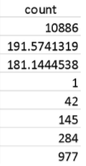
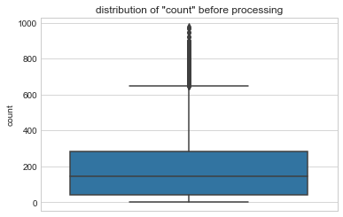
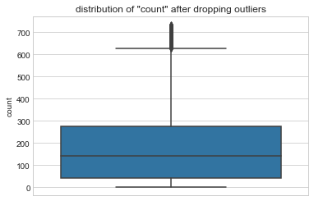
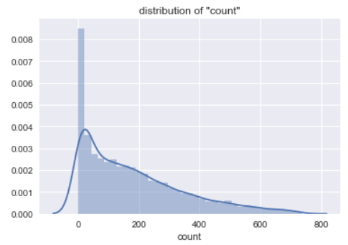
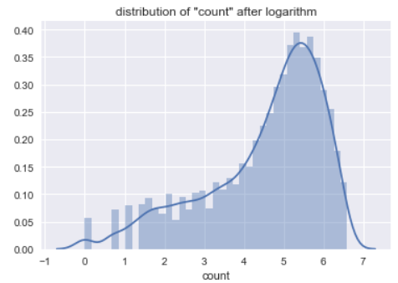
Feature Engineering – “count”
50 percentile: 145
75 percentile: 284
Max: 977
Estimation:
Outliers?
Remove the values outside of 3 standard deviations
Taking logarithm on target “count”

Slide 6
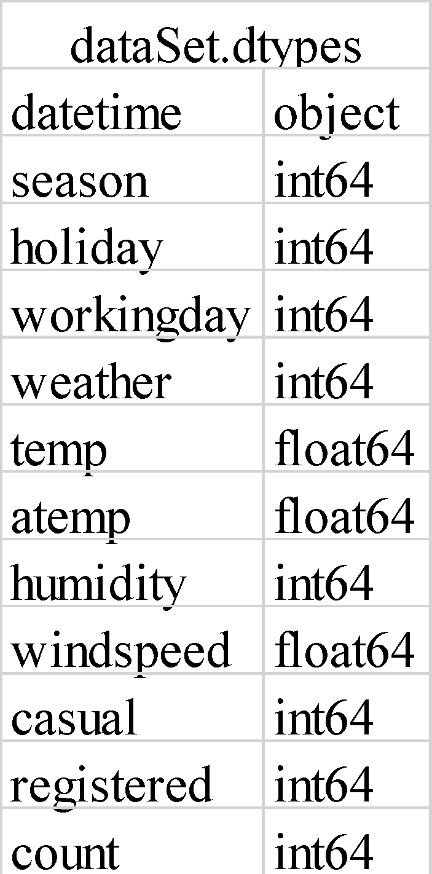



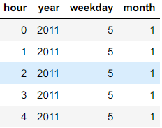
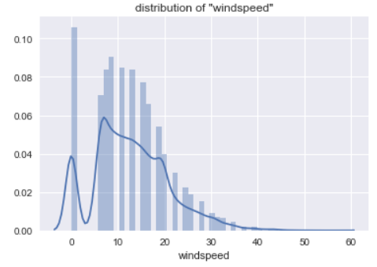
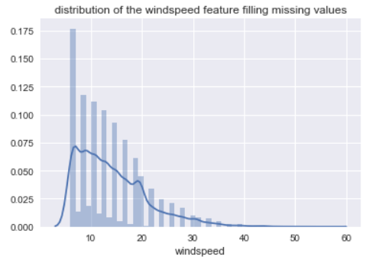
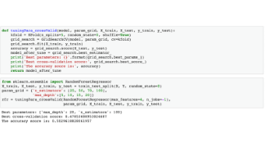
Feature Engineering - Others
windCol = ["season", "weather", "humidity", "temp”, "atemp“, "month”, “year”]
Use Random Forest model to fill the missing values (zero values) in “windspeed” feature

Slide 7
Methodology
Linear Regression Model with MinMaxScaler method
Random Forest
Boosting Algorithm
  Gradient Boosting
  XGBoost Model
    Tree Pruning backwards after splitting until reach maximum depth
  AdaBoost

Slide 8


Linear Regression w/ MinMaxScaler
Start with simple statistical technique as we learned in progress in this course.
Reason: Simple model can set the standard and guide us a direction, to evaluate if the model is too easy or complex.
Both X_train and X_test have low R² scores, which could generate a summary:
Linear Regression model is underfitting.
Then, bring in MinMaxScaler, transforms train_set features by scaling each feature to a given range [0, 1].
Comment: still not fitting well.
Improvement: complex/ensemble Models

Slide 9
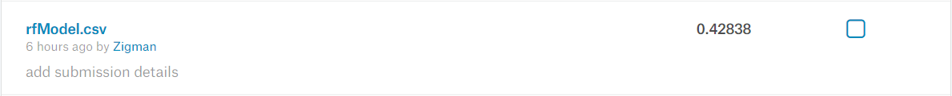
Random Forest
* Regularization is not applied：1. Overfitting; 2. Large amount of features; 3. low ratio of observations to features
Ensemble Model: 1. lower biases (averaging); 2. reduce variance; *3 avoid overfitting.
First try: Random Forest
It looks really great in train dataset. Then we apply the model in test dataset.
Class of model:
g(x)=f₀(x)+f₁(x)+f₂(x)+...
where g is the sum of simple base models f_{i} (base classifier: decision tree)
In our case, since we have large amount of training instances and underfitting, we can set:
num_tree: large as memory allows
min_child_weight: low
max_depth: increase

Slide 10
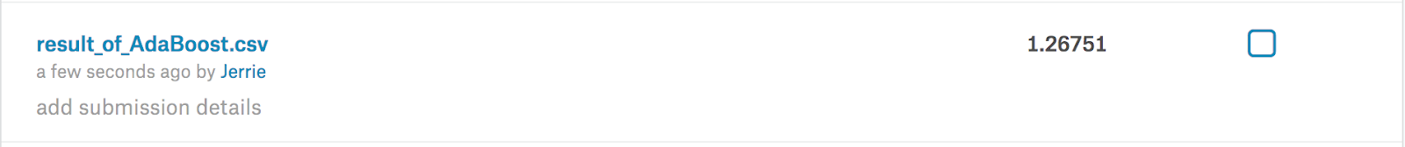
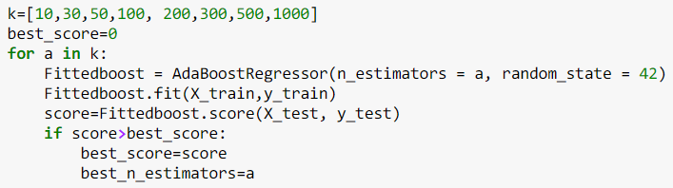

Boosting Algorithm
Gradient Boosting and XGBoost:
Additive training approach to boost the performance of the algorithm
Adaptive Boosting:
It uses multiple iterations to generate a single composite strong learner and it is more resistant to overfitting. We tried to adjust the number of n_estimators to get the best score.

Slide 11

Results
Submissions are evaluated on the Root Mean Squared Logarithmic Error (RMSLE).
Where:
n is the number of hours in the test set
p_{i} is your predicted count
a_{i} is the actual count
log(x) is the natural logarithm
For the method Linear Regression in Python, the RMSLE score after the submission of prediction is 2.67093. Then using transformed datasets to fit Train dataset, we obtain a better score after submission which is 1.20505.
For the method Random Forest in Python, the RMSLE score after the submission of prediction is 0.42282.
For the method Gradient Boosting in Python, the RMSLE score after the submission of prediction is 0.42282. For the method XGBoost in Python, the RMSLE score after the submission of prediction is 0.40122.
For the method Adaptive Boosting in Python, the RMSLE score after the submission of prediction is 1.26751.
https://www.kaggle.com/c/bike-sharing-demand#evaluation

Slide 12
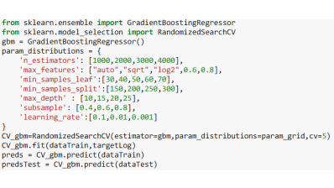
Conclusion
Low Accuracy
  Model is too simple
  Mixture of numerous and categorical features
High Accuracy
  Ensemble models are good at handling tabular data with qualitative and quantitative features.
  Both Random Forest and Boosting algorithms are able to capture non-linear interaction between features and target.
Future Plan
RandomizedSearchCV (expensive runtime)
Consider two other dependent variables - "casual" and "registered"
https://turi.com/learn/userguide/supervised-learning/boosted_trees_regression.html
https://turi.com/learn/userguide/supervised-learning/random_forest_regression.html

Slide 13
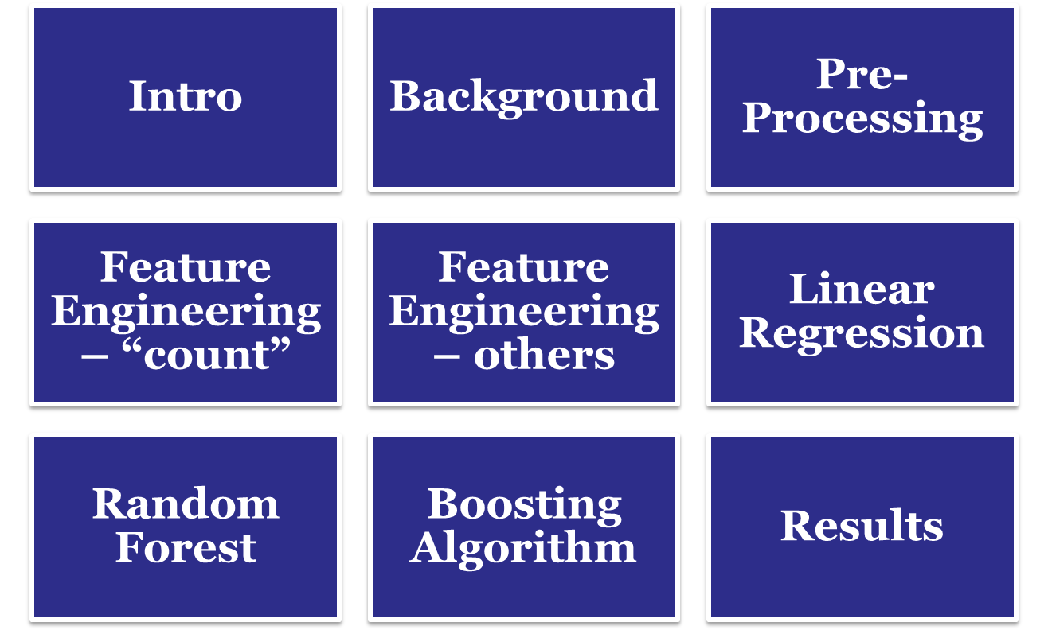
Q&A

Slide 14
References
Data Science Central. Introduction to Classification & Regression Trees (CART). 3 December 2017. <https://www.datasciencecentral.com/profiles/blogs/introduction-to-classification-regression-trees-cart>.
DMLC. Introduction to Boosted Trees. 3 December 2017. <http://xgboost.readthedocs.io/en/latest/model.html>.
Fanaee, Hadi T and Joao Gama. "Event labeling combining ensemble detectors and background knowledge." Progress in Artificial Intelligence (2013): 1-15. Springer Berlin Heidelberg.
Kaggle Inc. Bike Sharing Demand. 28 May 2015. <https://www.kaggle.com/c/bike-sharing-demand>.
MathWorks. AdaBoost. n.d. 15 April 2018.
Muller, Andreas and Sarah Guido. Introduction to Machine Learning with Python. O'Reilly Media, 2016.
Ray, Sunil. "Kaggle Bike Sharing Demand Prediction." 25 June 2015. Analytics Vidhya. 15 April 2018.
scikit-learn. MinMaxScaler. n.d. 15 April 2018.
scikit-learn. RandomizedSearchCV. n.d. 15 April 2018.
turi. Turi Machine Learning Platform: Random Forest Regression&Gradient Boosted Regression Trees. n.d. 15 April 2018.

